Slide 1
Documentation
2019 Planning Meeting
1/14/19 – 1/16/19

Slide 2
AGENDA
SWOT Analysis
VOC: Survey Review
Process Mapping
Future Vision
Meeting Topics
Policies
Best Practices
Action Items
Questions
Maintenance Tasks

Slide 3
SWOT Analysis
STRENGTHS | WEAKNESSES
Responsive PMO Team (insights and advocates) | Low value/perception Lack of recognition Lack of product knowledge Inability to self-test/QA content
OPPORTUNITIES | THREATS
Stronger collaboration Standardization Single-sourcing Leveraging technical services data and feedback | Lack of information, esp. change status Lack of initial product information – what’s new or changing

Slide 4
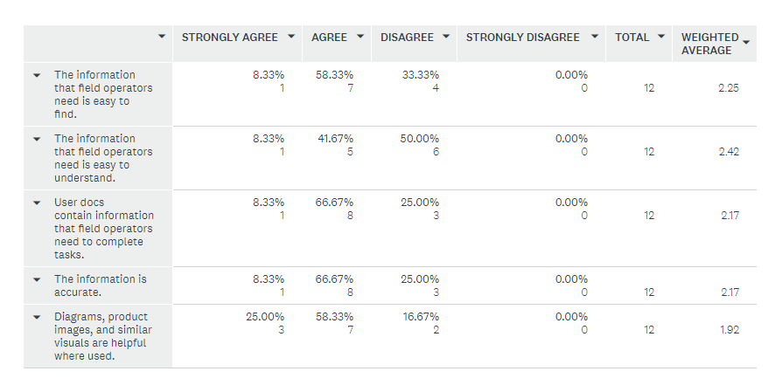
Voice of the Customer: Survey Review
Respondents agree that information is trusted but difficult to understand.
Q1: Please rate these statements based on your impressions and feedback from our customers:

Slide 5
Voice of the Customer: Survey Review
Q2: We can improve our user docs dramatically by…
  The tech writers having access to test systems.
  There is quite a bit of information contained in the user docs, but there is so much information it can be overwhelming when searching for something specific due to the fact that all information is immersed into the guide where users may not want to use it at times.
  Having access to them.
  Somehow determining which documents are used by our customers/partners. Just because we have always produced a certain type of document does not mean it is ever referenced. If we can somehow introduce a count which is incremented each time a specific type of content is accessed then we could better understand what documents are actually referenced. We do not want to optimized (or even produce) documentation that is rarely used.

Slide 6
Voice of the Customer: Survey Review
Q2: We can improve our user docs dramatically by…
  Creating a Quick-Start version, and separate detailed version for reference.
  Allocating equipment to the tech writers so they could get hands-on experience; which will result in improved user guides.
  Giving our doc writers the actual equipment configurations customers will be using when the docs are written.
  I think the user guide needs to be streamlined a bit. Maybe make it more modular to compartmentalize info for certain sections. It tends to jump around a bit. More emphasis needed on field updates.
  Writing product-specific documents. Currently, the documents address several variants. This creates an unnecessarily large and intimidating document(s).
  Simplification.
  Modernizing our look and feel; coordinating and delivering more embedded user assistance; collaborating and single-sourcing more with Tech Services and other teams to present a unified doc experience.

Slide 7
Voice of the Customer: Survey Review
Q3: Complete this statement: I can personally support user doc improvements by…
  Having a tool to log doc changes/errors easily as they are found.
  Reporting any errors or problems with them.
  Planning customer documentation tasks and task dependencies more accurately in the overall project plan.
  Soliciting direct feedback from customers on our supporting documentation.
  Reviewing when time is available.
  Providing input and explanations of functionality. Maybe we need to make this part of the development cycle and track this specifically as a step to completion of a project.
  Supplying customer-directed information.
  By finding more efficient ways to streamline the content creation process so that tech writers can focus more on content quality rather than delivery, formatting, and other aspects that I believe should be more automated.

Slide 8
Process Mapping
Current State
Future State
Planning - minimal.
Development - begins with assumptions and unknowns.
Review/Edit - cycle repeats multiple times as product scope is refined.
Delivery - cumbersome w/ PLM work, tracking signoffs, etc.
Planning - Doc Design Plan to establish scope and shared understanding.
Development – preliminary analysis and initial work that can be done. Draft to QA. PLM work (PN setup) during QA review.
Review/Edit – includes formal Doc walkthrough and final adjustments/edits.
Delivery – final uploads and signoffs to deliver.

Slide 9

Wow! The Documentation team is/are…
Included and Involved (early in the process).
Respected and Appreciated (our work eases load in areas like Tech Services)
Approachable and Collaborative (easy to work with)
Consultative (input to all areas of user assistance)
User Advocates
Accountable w/ project visibility and a formal request process
INFLUENCERS!
We aspire to be…

Slide 10
Meeting Topics
Methods
Tools
Standards
Information Mapping
Documentation Project Management
Minimalism
Screenshot Best Practices
Flare – anatomy of a project
Flare – using conditional text
Flare – using variables
Flare – best practices
SnagIt – best practices
TFS – Doc bug list
Product Names – see Price List
User Interface Elements – UI update; Tech Srvs input needed
Preferred Terms
Graphics
Headings – title case
Hyphenation – reduce; correct in style sheet

Slide 11
Meeting Topics
Doc Policies
Questions
Maintenance
PDF and DOC in PLM
No work without charge codes (beyond a consult or estimate)
TFS Bug List – check w/ Ed
Use of historic data for estimates - available
Who can access which drives – BP: Common Docs
No feedback email allowed
Content audit – esp. projects without PNs in TFS
Main/Core (MC) Flare project
Common content – index, acronyms, etc.
Editing checklist

Slide 12
Action Items
User persona - Done
Doc process maps – Current vs. Future
Doc feedback email - Declined
Factor estimates for doc baseline – Done
  Number of changes - XS (1-24); S (25-49); M (50-74); L (75-99); XL (100+)
  Complexity – Basic – 1; Advanced – 3; Complex – 9
  Time – average 12 minutes per item.
  # of changes * Complexity * Time, ex. 5 basic, 6 adv and 4 complex =
  (5*1*12) + (6*3*12) + (4*9*12) = 60 + 216 + 432 = 612 min/60= 11.8 hrs
  Final consideration - % of available tech writer time since we are allocated to multiple projects.

Slide 13
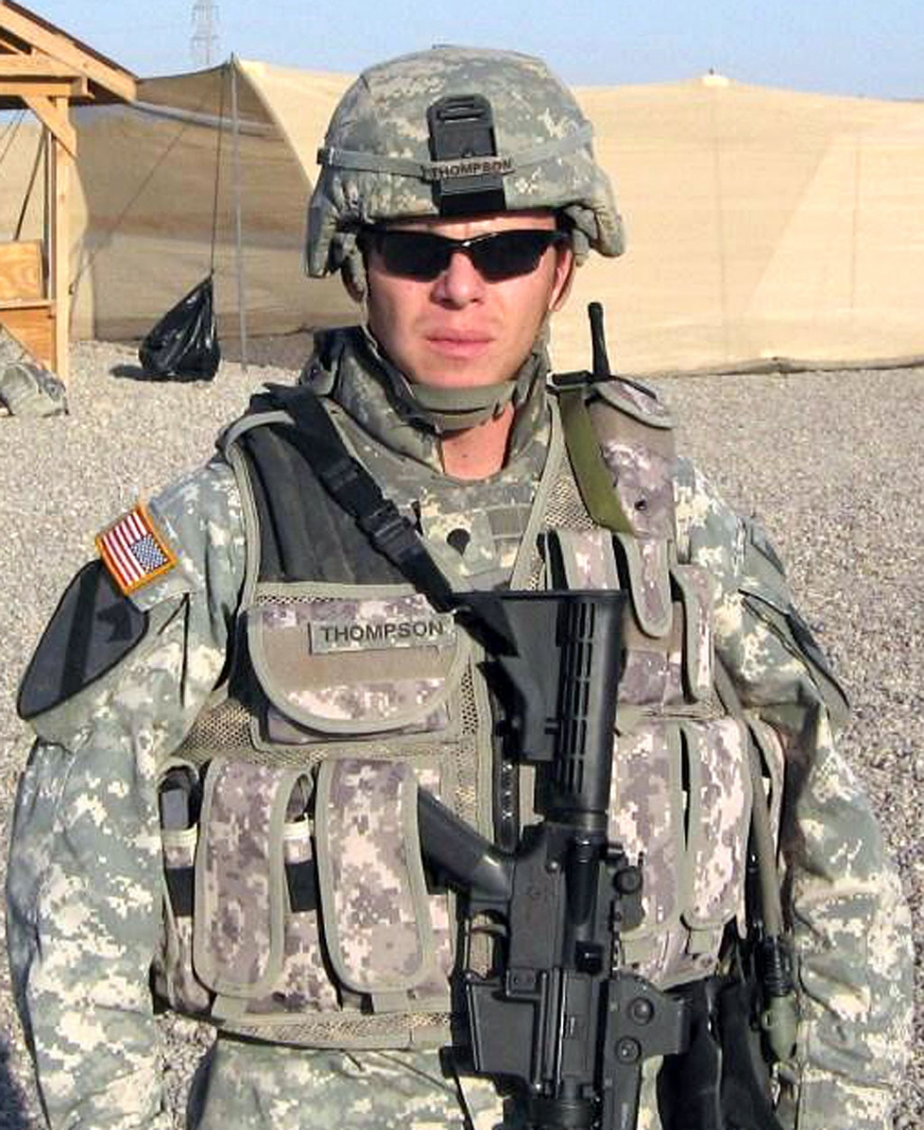
Meet SPC E4 Marvin Thompson
Gender: Male
Age: 24
Current Location: Middle East
Military Branch and Rank:
Army, enlisted Specialist-4
Education: GED
Goal/Priority: Find the bad guy! Gather intel.
Technology Experience: Comfortable with internet, gaming, social media, smartphones, gadgets galore!
Motivation: Staying alive! Contributing to the success of the mission, being part of the team.
Irritated when: gear doesn’t work, issue occur with hardware discovery, cryptic error messages occur, has to contact SRT for technical support.
Needs/expects docs to be: find information quickly; validation of sequencing; knowing which documents contain what information.
Familiar with: military terms & culture.
Unfamiliar with: how something like Mission Manager or LANShark or hardware actually works.
Environment: “Challenging” If gear isn’t mounted w/ brackets, screws, bungee cords may be used to mount equipment.
Noisy – choppers; Vibrations – HUMVs; rough roads; Distracting – interruptions, observing surrounding, watching for various
threats.

Slide 14
Topic-based Authoring
A modular approach to content creation where content is structured around topics that can be mixed and reused in different contexts. It is defined in contrast with book-oriented or narrative content, written in the linear structure of written books.
This authoring approach is popular in the technical documentation. Tools supporting this approach typically store content in XML document format in a way that facilitates content reuse and makes the dynamic assembly of personalized information possible.
A topic is a discrete piece of content that is about a specific subject, has an identifiable purpose, and can stand alone (does not need to be presented in context for the end-user to make sense of the content). Topics are also reusable. They can, when constructed properly (without reliance on other content for its meaning), be reused in any context anywhere needed.

Slide 15
SRT Technical Writers Wear Many Hats
Responsible for all aspects of user-facing documentation: content, structure, format, and behavior. We are:
  Authors who research, write, and edit information.
  Information architects who control topic naming, mapping, content models, reuse strategies, and taxonomies.
  Usability specialists who test our own instructions wherever feasible.
  Photographers who take pictures of equipment.
  Graphic designers who create visual communication.
  Editors who impose writing standards and enforce consistency.

Slide 16
DITA Overview
DITA –(Darwin Information Typing Architecture) concepts are helpful, even outside of a DITA authoring practice:
  XML (open standard) data model for authoring and publishing
  A Task topic is intended for a procedure that describes how to accomplish a task. It lists a series of steps that users follow to produce an intended outcome. The steps are contained in a taskbody element, which is a specialization of the generic body element. The steps element is a specialization of an ordered list element.
  Concept information is more objective, containing definitions, rules, and guidelines.
  A Reference topic is for topics that describe command syntax, programming instructions, and other reference material, and usually contains detailed, factual material.
  A Glossary Entry topic is used for defining a single sense of a given term. In addition to identifying the term and providing a definition, this topic type might also have basic terminology information, along with any acronyms or acronym expansions that may apply to term.
  The Troubleshooting topic describes a condition that the reader may want to correct, followed by one or more descriptions of its cause and suggested remedies.

Slide 17
Minimalism Overview
Minimalism
Reduce interference of information delivery with the user’s though process. Good writing means that the message is directly clear to the projected audience. Adopting a minimalist method may appear, in the short-term, to cost more, as writers must cut up and rephrase content into single free-standing chunks.
Recommendation: https://www.slideshare.net/TCUK_Conference/tcuk-2012-leah-guren-golden-rules-redux-14713539

Slide 18
Information Mapping Overview
Information Mapping is a methodology for analyzing, organizing, and presenting information.
Based on six information types: Procedure, Process, Principle, Concept, Structure, and Fact.
Includes six principles for organizing information so that it is easy to access, understand, and remember: Chunking, Relevance, Labeling, Consistency, Accessible detail, and Integrated graphics.
Recommendation: https://en.wikipedia.org/wiki/Information_mapping

Slide 19
Conclusions/Next Steps
Prioritize action items
Add tech segment to team meetings
Define our “line in the sand” (criteria valuation to apply new methods/techniques vs. minimum maintenance)

